Slide 1

Walmart Stock and Financial analysis
Notes:
Garrett

Slide 2





Team Introduction
Systems Tech: Andre Xie
Design Lead: Mohammad Aydin
Domain Expert: Ed Osmulski
Scrum Master: Garrett Jones
Developer: Max Landa
Notes:
Garrett
We have 5 team members. Andre is responsible for tech research and general system troubleshooting. Mohammad is responsible for data visualization. Ed (OZ-MULL-SKI) acted as our Domain Expert where he created the database and queries. Max was in charge of creating the Spark codebase. Our scrum master was Garrett who was responsible for scheduling tasks and resolving blockers for the team.

Slide 3
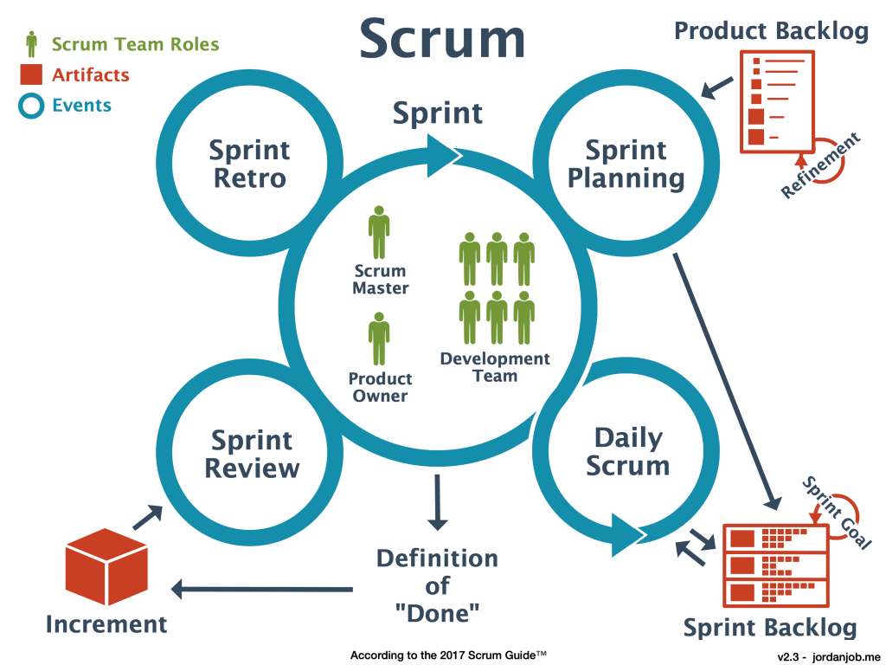
Development Method
Planning:is to define what can be delivered in the sprint and how can that be achieved.
Project tracking tools:
Linear
-similar to Jira
-provides task assignment and bug tracking
Sprint retrospective: is a meeting to discuss what went well during the previous sprint cycle and what can be improved for the next sprint.
Sprint Review: to inspect the outcome of the sprint and determine future adaptation
Daily Scrum:is an internal meeting for the scrum team
Notes:
Garrett
Our development method is called Agile Scrum. Agile scrum uses sprints which are designated periods of time where a unit of work is set to be accomplished. Agile scrum is composed of four stages. The first stage Sprint Planning involves producing a Product Backlog which is like a todo list. The next phase is the Daily scrum which is a short period of time where each member gets the opportunity to discuss what they have accomplished and any issues they faced, during this phase any tasks on hold will be added to the Sprint Backlog. The third phase is the Sprint Review where the result of the sprint is examined. Finally, the fourth phase, the sprint retrospective, is basically a celebration of the groups achievement and where improvements on the next sprint are discussed.

Slide 4
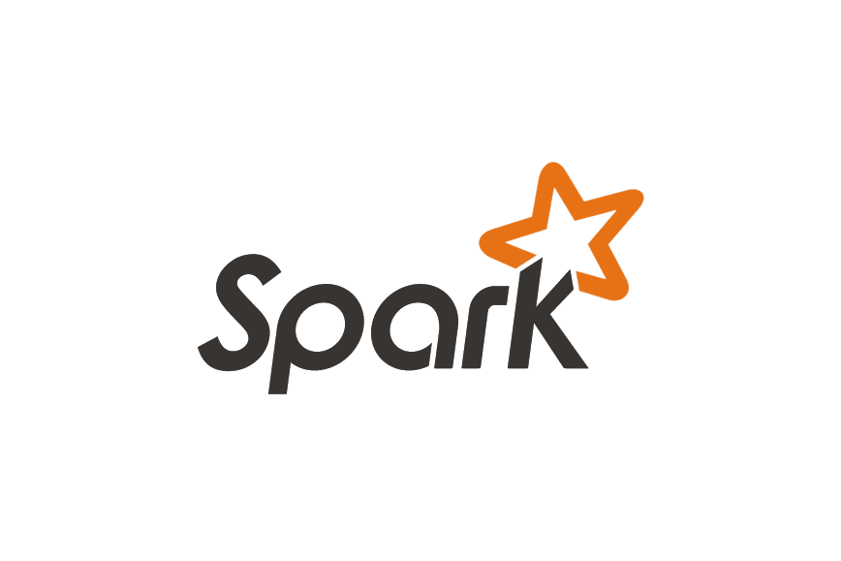
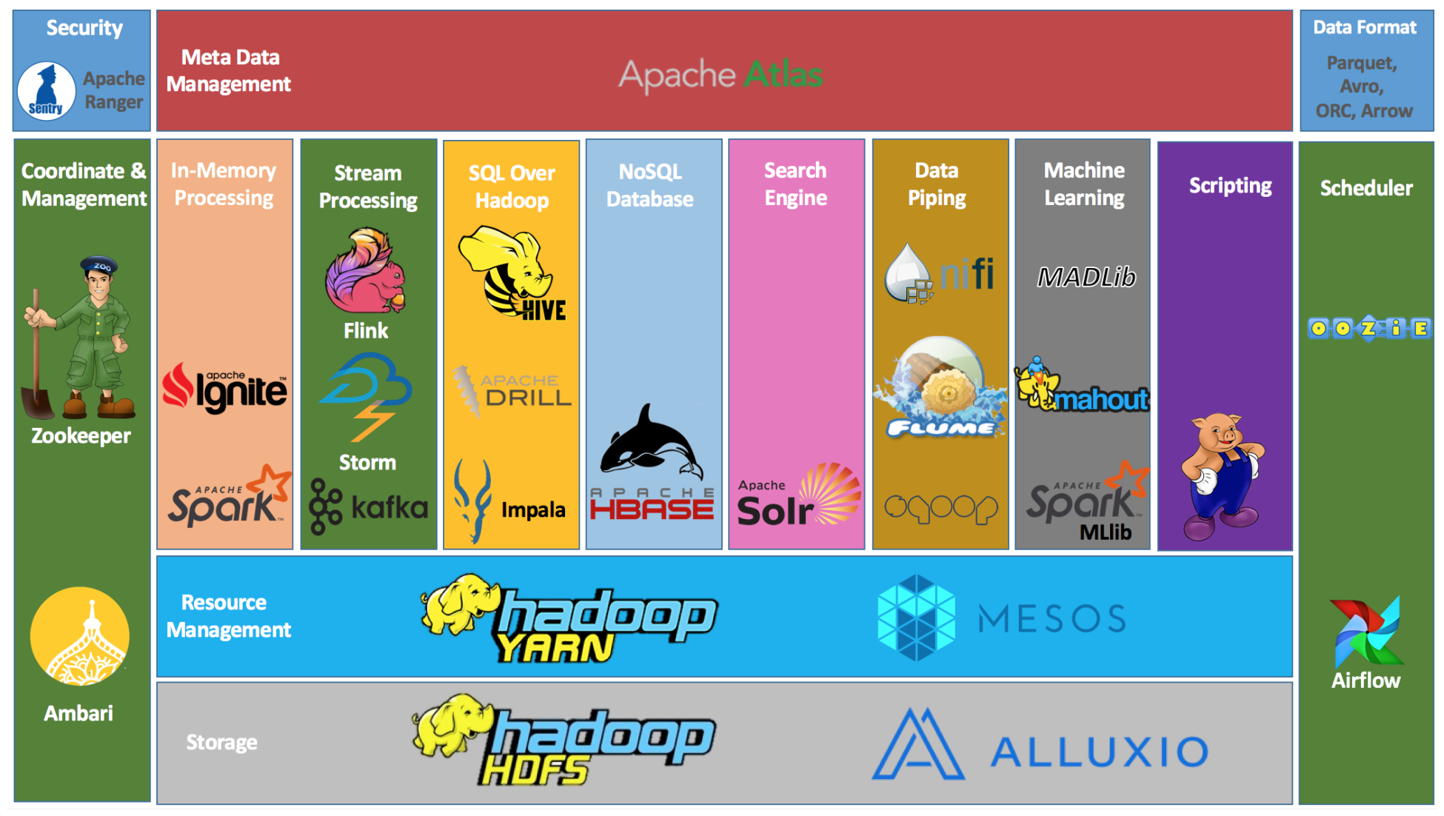

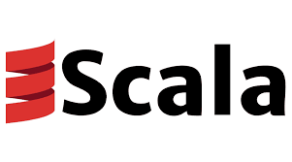
Techstack
Apache Spark is an open-source, distributed processing system used for big data workload. Utilizes in-memory caching and optimized query for fast queries against data of any size.
Apache Hive is an open-source data warehouse software for reading, writing and managing large data set files.
Scala is a high-level programming language that combines object-oriented and functional programming in one concise language.
Notes:
So our project utilizes three main technologies: Apache Spark, Hive, and Scala. Apache Spark is a framework for real time data analytics in a distributed computing environment. This is what we used to perform our data analysis. What makes it useful is that it utilizes in-memory caching which allows it to be 100x faster than Hadoop Map-Reduce in regards to data processing. We stored our numerous datasets in a Hive database which is a data warehousing component in the Hadoop ecosystem that performs reading, writing and managing large data sets in a distributed environment. To run our numerous queries for analysis, we utilized Scala to write scripts to run in Spark that interfaces with our Hive tables.

Slide 5
Dataset Overview
01
Stock Data(1972-2022)
Stock price:
Open, Close, Adjusted Close Volume
Dividends
02
Financial Statements(1986-2022)
Tables:
Balance Sheet(1986-2022)
Income Statement(1990-2022)
Cash Flow Statement (1990-2022)
03
Benchmark comparisons
Direct competitor performance stock prices
04
Macroeconomics
Inflation Rate Data
Unemployment Data
Data sources: Yahoo Finance & FRED (St. Louis Federal Reserve Economic Data)
Notes:
Our datasets are sourced from Yahoo Finance and the St Louis Federal Reserve Economic Data. There are over 6 tables containing stock data, financial statements, benchmark comparisons, and macroeconomics. Overall the data ranges from 1970s to 2022.
We spent a week and a half working with this dataset and developing this project.

Slide 6
Dataset Validation
Volume
Value
Variety
Velocity
Veracity
Data ranges from 1970 - 2022.
6+ tables.
Data tracks micro and macro economic events which impact sales and market sentiment.
Large amount of company financial resources tied to stocks.
Stock, dividends, unemployment, inflation rates, and financial statements included inside datasets.
Data generation rate
Daily
Quarterly
Annually
Secure validated sources (Yahoo, FRED).
Notes:
After finding a dataset, the next step in data analysis is the dataset validation. Basically, data analysts need to evaluate their data against certain criteria to make sure that the data is valid and meets task needs.
The first phase of evaluation is Volume.
We faced some issues here as we were unable to find a retail stock index which spans the whole 1970 - 2022 period. We ended up substituting this dataset for some macroeconomic data about inflation due to low volume.
The second phase is Value.
The value phase is incredibly important. A dataset with no value is not worth looking at. So why are our datasets valuable? Well, most of our datasets apply to stock, company financials, and macroeconomic data, all of which greatly impact company profits. Stock data is important because a massive amount of company financial resources are tied to stocks. Stock price is also an indicator of public sentiment towards the company. Also as a retailer walmart sales are heavily influenced by macroeconomics as you will see later.
The Third phase is variety.
Variety is the reason we included data about micro and macro economic events alongside the stock data for Walmart.
The fourth phase for validation is Velocity which describes how quickly data is generated.
For velocity we have a wide variety of generation rates including Daily, Quarterly, and Annually.
The fifth and final phase is Veracity:
Veracity in relation to Big Data is a characteristic related to the consistency, accuracy, quality, and trustworthiness of the data. With regards to the veracity of our data, all datasets used in this analysis come from the FRED (Federal Reserve Economic Data) and Yahoo Finance which are both secure and reputable sources.
I'm going to handoff the next phase of our presentation to my colleague Mohammed

Slide 7

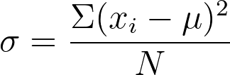
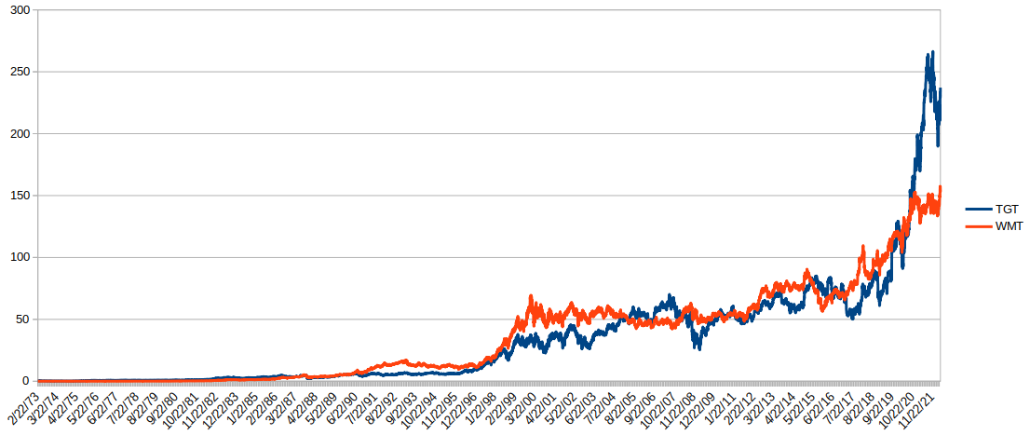
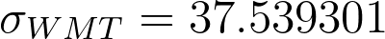
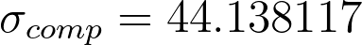
Problem Statements
What is the historical volatility of Walmart and one of its largest competitors?
Historic WMT and Competitor Stock Prices
Historical Volatility
SELECT STDDEV_POP(wmt.close) AS `Walmart Historical Volatility`, STDDEV_POP(tgt.close) AS `Competitor Historical Volatility` FROM wmt, tgt WHERE wmt.`date`=tgt.`date`;
Notes:
Why did we
Key takeaways: Walmart has a lower historical volatility than its competitor
Simple volatility is just standard deviation so 68% of expected stock prices should fall between 1 standard deviation above and below the average stock price
The Competitors stock price experienced a higher volatility to the upside compared to walmart. That can be a result from increased investment in the workforce, as a result lead to better customer experience and attracted a higher class customer base than walmart. Earned higher customer loyalty

Slide 8
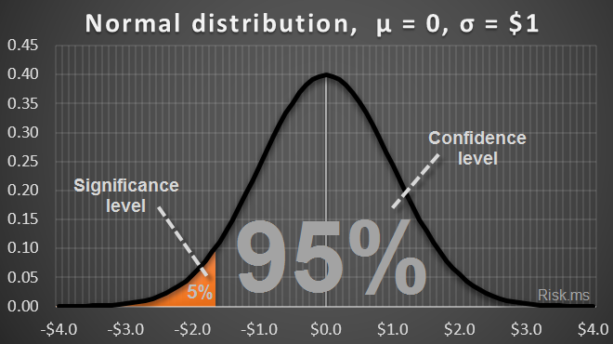
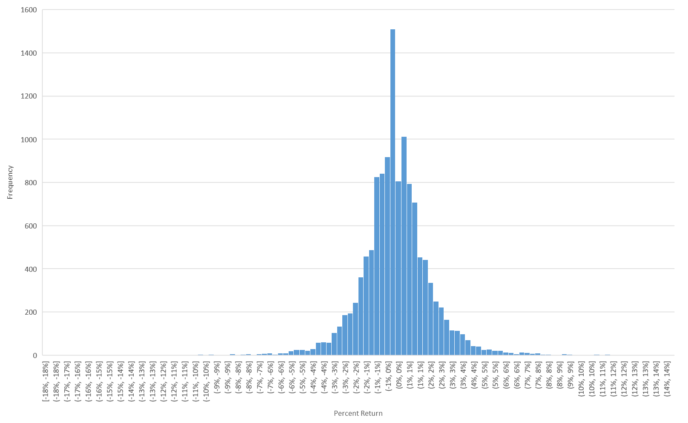
Problem Statements
What is the 95% and 99% VaR of Walmart?
VaR Calculation
SELECT (1.65 * STDDEV_POP(wmt.close)) AS `VaR 95%`, (2.33 * STDDEV_POP(wmt.close)) AS `VaR 99%` FROM wmt;
Notes:
We have this plot that represents the percentage of stocks return in our data set on x axis .and how many time did this value occurred on the Y axis . VAR stands for value at risk which is simply the maximum dollar amount expected to be lost over a given data sample, at a pre-defined confidence level. For example, if the 95% one-month VAR is $1 million, there is 95% confidence that over the next month the portfolio will not lose more than $1 million.

Slide 9
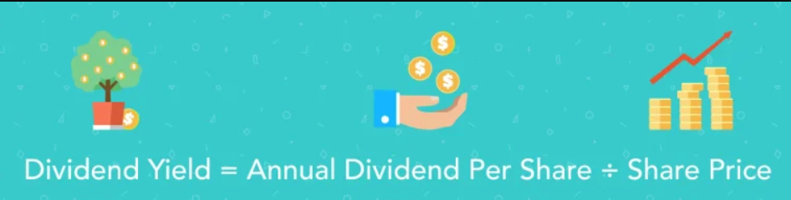
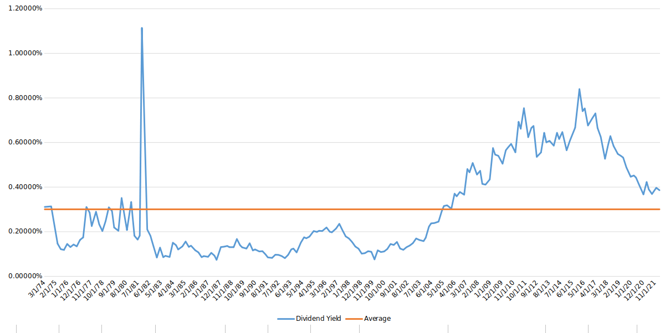
Problem Statements
What is the average dividend yield for Walmart over the years? Has it grown/declined?
Show dividends for each year.
SELECT wmt.`date`, (wmt_div.dividends/wmt.close) AS `dividend yield` FROM wmt, wmt_div WHERE wmt.`date` = wmt_div.`date` ORDER BY wmt.`date` DESC;
Show avg dividend over the 50 year period
Query
SELECT AVG(div_yield) AS `dividend yield` FROM(SELECT (wmt_div.dividends/wmt.close) AS `div_yield` FROM wmt, wmt_div WHERE wmt.`date`=wmt_div.`date`)wmt, wmt_div;
Notes:
Script:
On this slide we see the dividend yield of Walmart plotted over the 50 year period for which we have data
Walmart is value stock, that generally investors buy in order to reap the benefits of dividends. However, Walmart has rather abysmal dividend yields for being value stock.

Slide 10
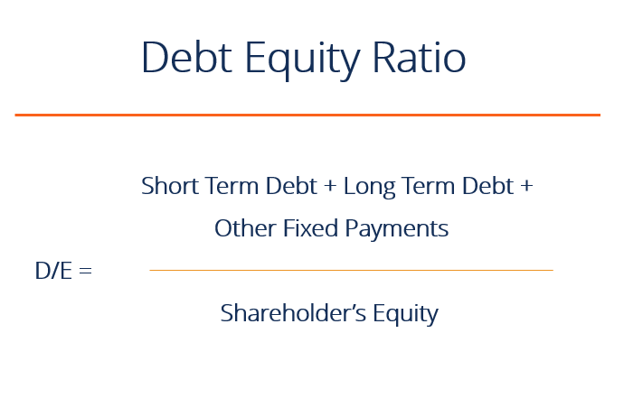
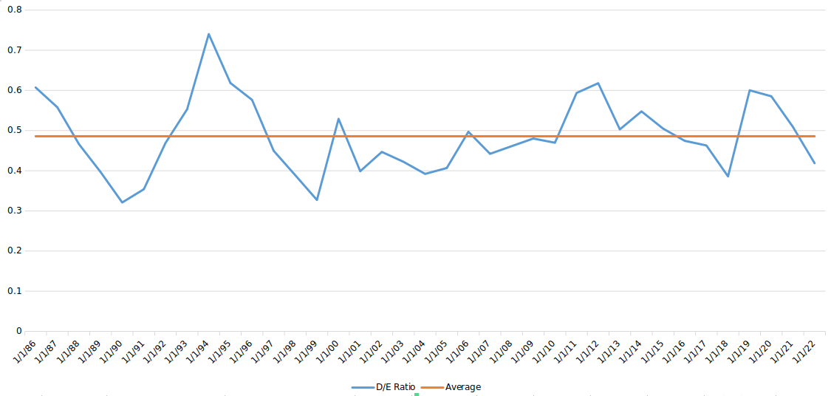
Problem Statements
What has the debt-equity ratio for Walmart been over the years? What is the average D/E ratio and what is the current D/E ratio in comparison?
Walmart Debt Equity Ratio
SELECT `date`, (long_term_debt/stockholders_equity) AS `D/E Ratio` FROM wmt_bal_sht ORDER BY `date` DESC;
Average Debt Equity Ratio
SELECT AVG(long_term_debt/stockholders_equity) AS `Avg D/E Ratio`, STDDEV_POP(long_term_debt/stockholders_equity) AS `Std Dev of D/E Ratio` FROM wmt_bal_sht;
Notes:
Ed
Script:
This slide shows the annual debt-to-equity ratio for Walmart from the years 1986 to 2022 in blue. And in orange is the average for that ratio over the same time period.
The debt-to-equity ratio is a metric to show how a company is attaining its capital, which can be used for things like expansions and new projects and new state of the art equipment
A high debt-to-equity ratio is indicative that a company is gathering its capital mostly from issuing debt to creditors or taking loans and using less of the gathered capital from the sale of shares and a low ratio is indicative of the opposite
As can be seen the average is just below the 0.50 mark, and the nominal values don’t fluctuate more than 0.25 from this average implying that Walmart may be using some relatively strict capital structuring policies to prevent leveraging the company. This may also stunt some growth as Walmart is unwilling to issue debt to raise capital for internal projects or expansions.

Slide 11
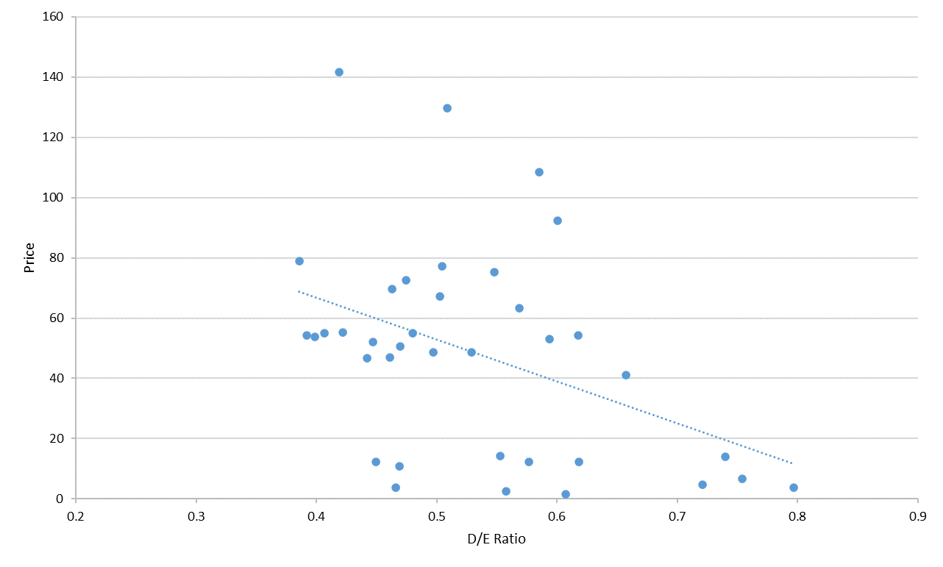
Problem Statements
What is the regressive relationship between D/E ratio and the stock price of Walmart?
Linear Regression: Price vs. D/E Ratio
SELECT REGR_SLOPE(de_ratio, price) AS `beta_1`, REGR_INTERCEPT(de_ratio, price) AS `beta_0` FROM(SELECT wmt.close AS `price`, (long_term_debt/stockholders_equity) AS `de_ratio` FROM wmt, wmt_bal_sht WHERE wmt.`date`=wmt_bal_sht.`date`)wmt, wmt_bal_sht;
Notes:
Ed
Script:
In this slide we see a linear regression of price versus the debt-to-equity ratio. OLS regressions are one of the simpler techniques for running analysis on datasets. This is a single regression where we only have one independent variable and one dependent variable.
This creates what is in effect a trendline in the style of y=mx+b. Where m is the slope and represents the relationship between the dependent and independent variables
From this graph we can see that there is a inverse linear relationship between price and debt-to-equity ratio. This means that as the debt-to-equity ratio increases, the price of Walmart’s stock decreases
This is because shareholders aren’t too fond of companies introducing more claimants to the company’s successes in the form of creditors who have priority in bankruptcy proceedings

Slide 12
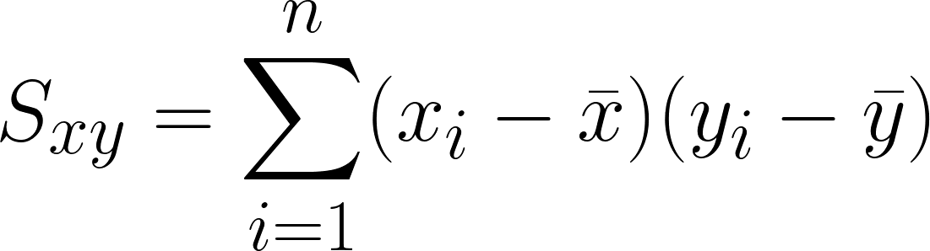
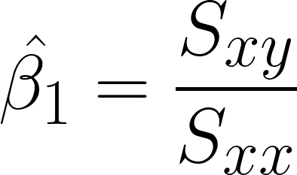
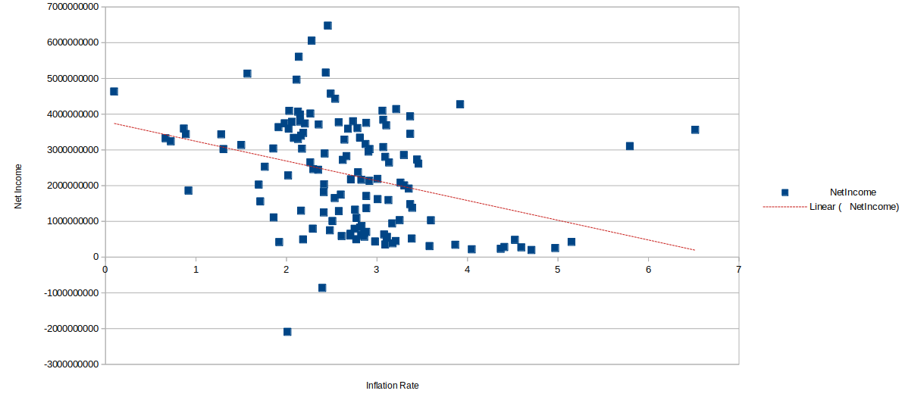
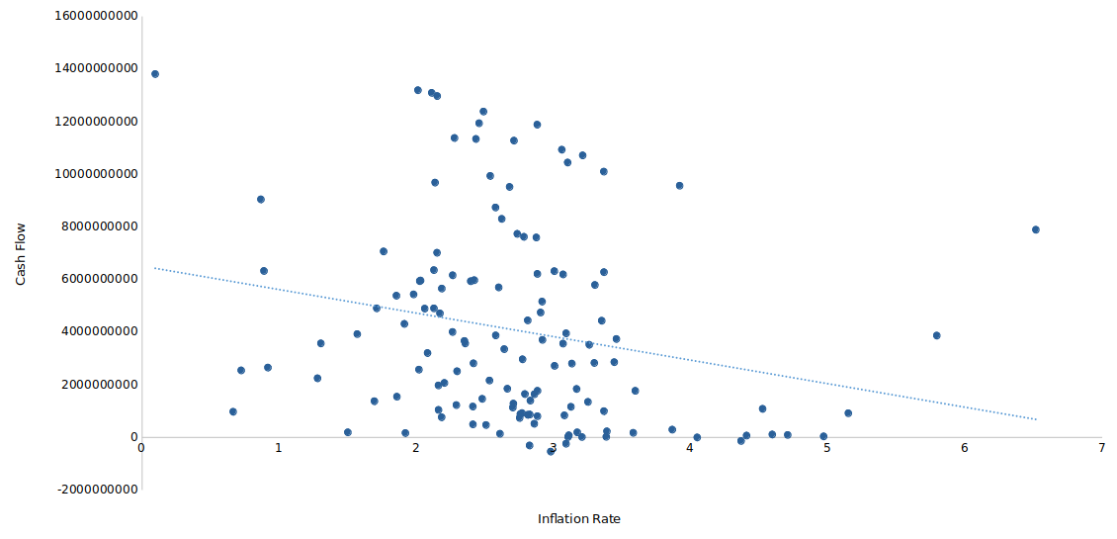
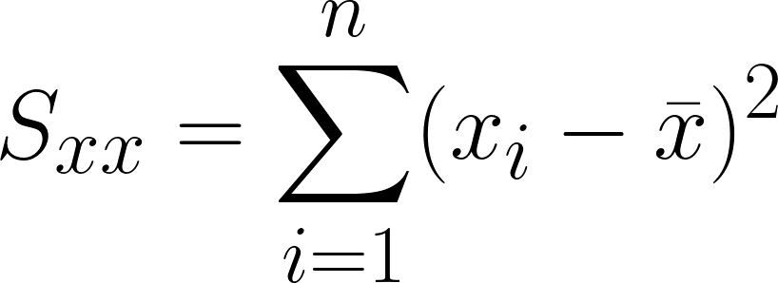
Problem Statements
What is the regressive relationship between the price and net income of Walmart and the prevailing inflation rate?
Net Income vs Inflation Rate
Operating Cash Flow vs Inflation Rate
SELECT REGR_SLOPE(qrtrly_infrate.infrate, wmt_qrtrly_inc_stmt.net_income) AS `beta_1`, REGR_INTERCEPT(qrtrly_infrate.infrate, wmt_qrtrly_inc_stmt.net_income) AS `beta_0` FROM qrtrly_infrate, wmt_qrtrly_inc_stmt WHERE qrtrly_infrate.`date` = wmt_qrtrly_inc_stmt.`date`;
SELECT REGR_SLOPE(qrtrly_infrate.infrate, wmt_qrtrly_csh_flw.operating_cash_flow) AS `beta_1`, REGR_INTERCEPT(qrtrly_infrate.infrate, wmt_qrtrly_csh_flw.operating_cash_flow) AS `beta_0` FROM qrtrly_infrate, wmt WHERE qrtrly_infrate.`date` = wmt_qrtrly_csh_flw.`date`;
Notes:
Ed
Script:
Here we see two more linear regressions , only these show percent change in CPI (or the inflation rate) and its effect on Net Income and the Operating Cash Flow of Walmart.
These graphs also show inverse relationships meaning that Walmart will begin to start losing money the higher the inflation rate is
As we can see the Net Income and Operating cash flow drops off rather significantly once inflation reaches approximately 3.5%
However, as you can see the cluster of data points on these graphs and the one on the previous slide don’t match the trendline with incredible closeness and as such the model may not fit perfectly to the data having a low adjusted R2 value
\hat{\beta_1} = \frac{S_{xy}}{S_{xx}}
S_{xy} = \sum_{i=1}^n(x_i-\bar{x})(y_i-\bar{y})
S_{xx} = \sum_{i=1}^n(x_i-\bar{x})^2

Slide 13
Discovery
Walmart has a lower volatility in its stock prices as compared to one of its closest competitors
VaR 95% & 99% is 3.07% and 4.33%
Historic dividend yield has hovered below 1% for 50 years
Current dividend yields have been above the 50 year average for 15 years.
D/E ratio hovers around 0.5 and is currently below the average for Walmart.
Price vs. D/E ratio
For every unit increase in D/E ratio price decreases by $5.69.
Net Income vs. Inflation
For every 1% increase in Inflation income decreases by $65.3 million.
Operating Cash Flow vs. Inflation
For every 1% increase in Inflation operating cash flow decreases by $54.9 million.
Notes:
Our data shows that Walmart has low volatility as expected of a value stock.
The Value at Risk (VaR) shows with 99% certainty that 4.3% is your worst case loss scenario.
Historic dividend yield has hovered around 1% for the last 50 years but since 2007 the dividend has been above the average.
Debt to equity ratio is below the average for walmart at .5
For every .1 increase in the Debt to equity ratio, the price of Walmart falls by almost $6 dollars.
And finally for every 1% increase in inflation operating cash flow decreases by $54 million.
Volatility
VaR 99% certainty 4.3% loss
We found that Walmart is a very strong value stock in that the volatility is lower than competitors. Additionally, the Value at Risk is only 4.33% which means that the worst case value loss on this stock is minimal. Walmart also has a very strong Debt to equity ratio at only .5

Slide 14
Impact on Business
Key Points
Steady stock price growth(market cap) reflects a healthy company
Low dividend yields over a 50 year period reduce the attraction of value stocks like Walmart.
Non-fluctuating D/E ratio implies strong capital structuring requirements to prevent overleveraging.
The Price-D/E ratio regression show that increasing the level of leverage would hurt public perceptions of the companies value.
Current fears with inflation:
The last 2 regressions show that income and cash flows respond very negatively to increases in inflation.
For income, it seems that after ≈3.5% inflation the income of Walmart drops sharply.
Notes:
So why are our

Slide 15
Recommendations
If prevailing trends of inflation continue, Walmart may need to abandon their strict capital structuring controls in order to maintain a level of Net Income and Operating Cash Flow. However, this may cause a panic among equity investors as stock prices will likely fall as a result. Walmart should prepare for a lower income period if inflation numbers reach 3%+.

Slide 16
Code Demonstration

Slide 17
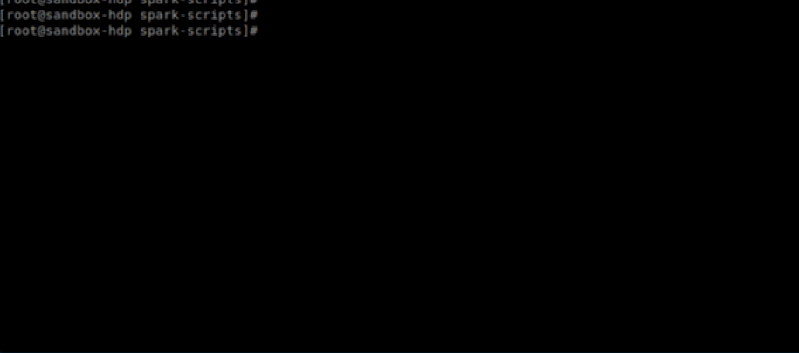
Apache Spark Application
How to enter application: $./start.sh
Notes:
Clone the git repository to your Linux system which has Java Virtual Machine (JVM), Scala, and Spark-shell installed on it. You can enter the application using the shell script stored in the root of the repo ‘start.sh’.
If your cluster manager(Yarn, Mesos, etc. . .) is stored on a remote machine you can start the spark shell manually, define the location of the cluster manager with a spark-shell flag and import the Scala script with the -i flag.

Slide 18
Schema
scala> wmt.printSchema
root
|-- date: date (nullable = true)
|-- open: double (nullable = true)
|-- high: double (nullable = true)
|-- low: double (nullable = true)
|-- close: double (nullable = true)
|-- adj_close: double (nullable = true)
|-- volume: double (nullable = true)
scala> HiveHandler.
VaR dividendOver50 highestVolatility ratioOverYears
betaValue dividendOverYears ratioBeyondLimits standardDeviation
Example:
Var stock = DF
HiveHandler.VaR(stock): returns a new dataframe
Notes:
This is a table we. A table in hive is created in columns and rows.Data type RDD Hive table in scala. You can perform sql queries on the variable. Call column name and execute some sql queries to get information from what you know to get data you you don’t know. Spark store tables across multiple computers call node using cluster manager. Structure dataset is distributed across the cluster.
For the Schema there are some dynamic functions functions
(highestVolatility) historical volatility of Walmart (ratioOverYears)average dividend yield for Walmart over the years
(dividendOver50) avg dividend over the 50 year period (VaR)Value at Risk

Slide 19
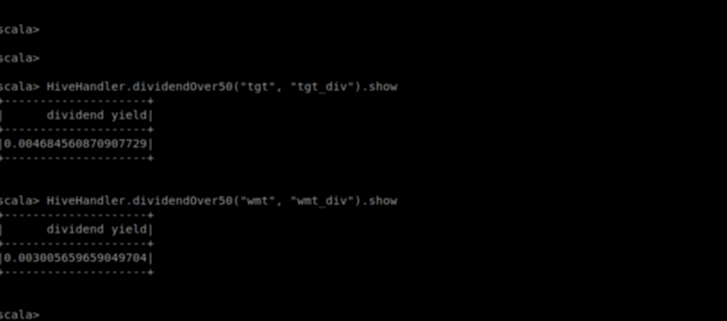
Demonstration
Notes:
This is the demonstration of the application showing some statistics results. That apply characteristics of Volume, value,variety, velocity and veracity and manage data interactively.

Slide 20
Closing Statements
Questions?

